Slide 1

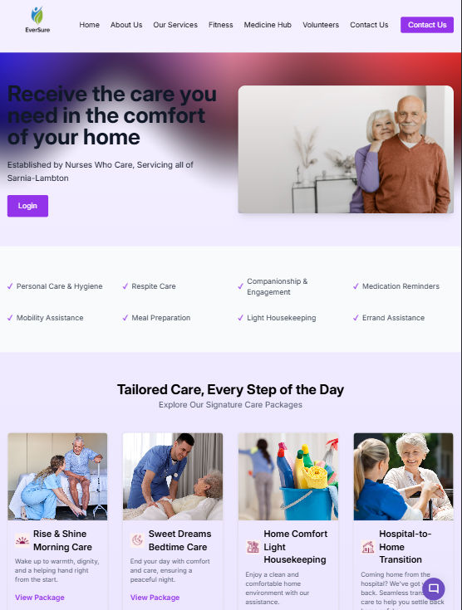


EverSure
Care that comforts, support that never fades
Presented By- Dhruv Chotalia
4

Slide 2
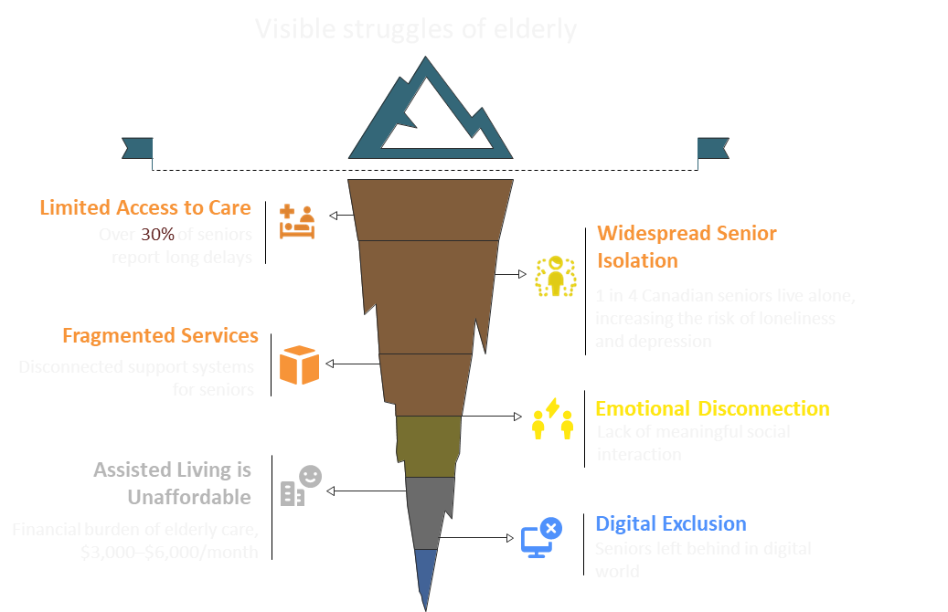
9

Slide 3
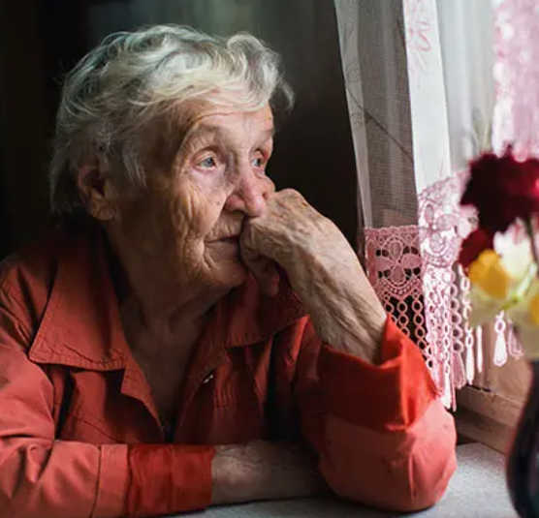
Current Solutions
Fragmented & Inaccessible Services
Seniors and families struggle to navigate between multiple apps, agencies, and platforms—none offering all-in-one support.
Lack of Emotional & Social Engagement
Most platforms focus only on medical or physical care, ignoring loneliness, mental health, and cognitive stimulation.
Limited Use of Technology for Preventive Care
Existing services are reactive rather than proactive.
9

Slide 4
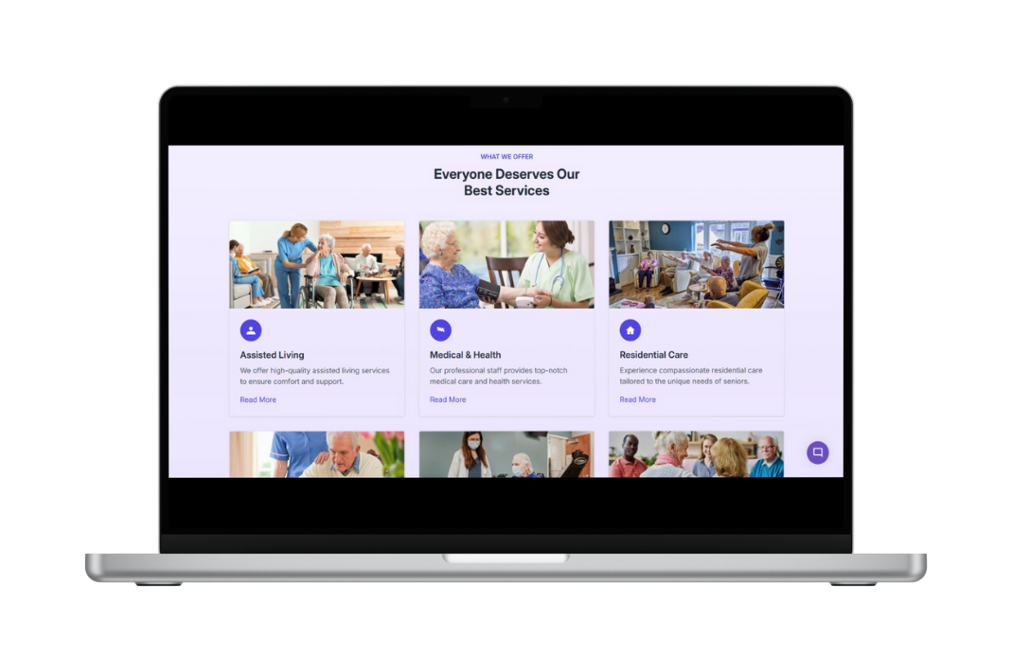
THE SOLUTION
EverSure
We aim to deliver an affordable, all-in-one digital companion that bridges care, connection, and accessibility—empowering seniors to live independently with dignity.

Slide 5
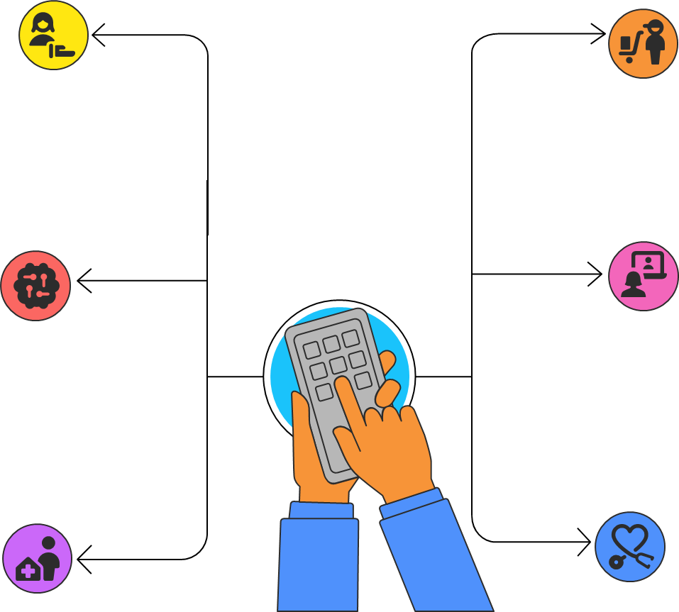
EverSure Services
Tailored Care Packages
Smart Errand
Concierge
Personalized support routines for every lifestyle.
Errand help for every lifestyle.
InterGen Connect Program
Cognitive Fitness
Club
Gamified brain training
and social competitions.
Weekly video or in-person sessions pairing seniors with students for companionship
Hospital-to-Home
Transition
Professional-Grade Medical & Emotional Support
10

Slide 6
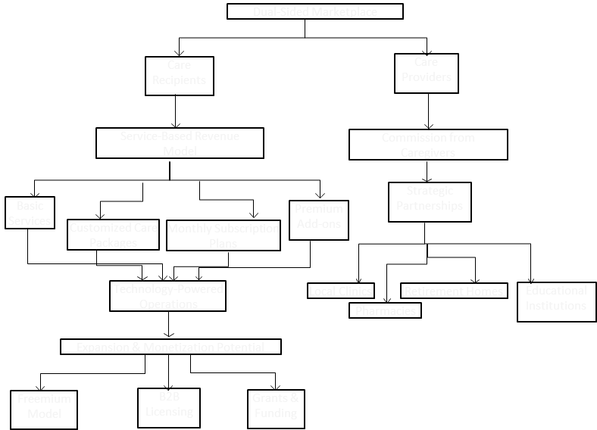







Business Model
5

Slide 7

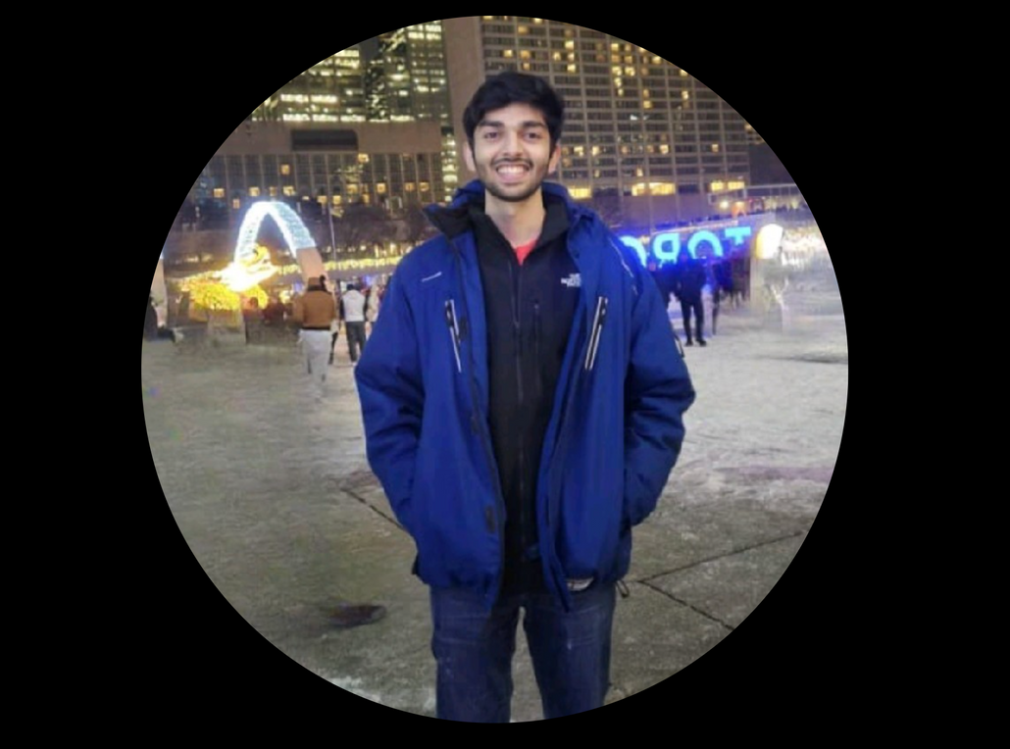
Management Team
DHRUV CHOTALIA
Founder / CEO
Student at Seneca Polytechnic
8

Slide 8




Competition
Comprehensive Senior Support
Fragmented & Expensive
Integrated & Affordable
I want my elderly parent to get reminders for medications, hydration, and doctor visits
I want companionship support without relying on family 24/7.
I need emergency help available at all times, even when I’m not nearby.
I want someone to check in emotionally and mentally with my loved one.
I want a reliable and affordable option — without installing complicated devices.

Slide 9




Serving Those Who Matter Most
Primary Segment: Senior Citizens (Aged 60+)
Secondary Segment: Family Caregivers
Institutional Segment
Individuals living independently, with early to moderate cognitive or physical decline
Need support with medication reminders, companionship, emergency response, and digital literacy
Value simplicity, trust, and reliability
Senior Care Facilities & Retirement Homes
Orphanages & Intergenerational Programs
Implement volunteer modules to foster community and care-sharing across generations
Adult children and caregivers looking to monitor, support, and engage with aging loved ones remotely
Demand transparency, real-time updates, and peace of mind
10

Slide 10

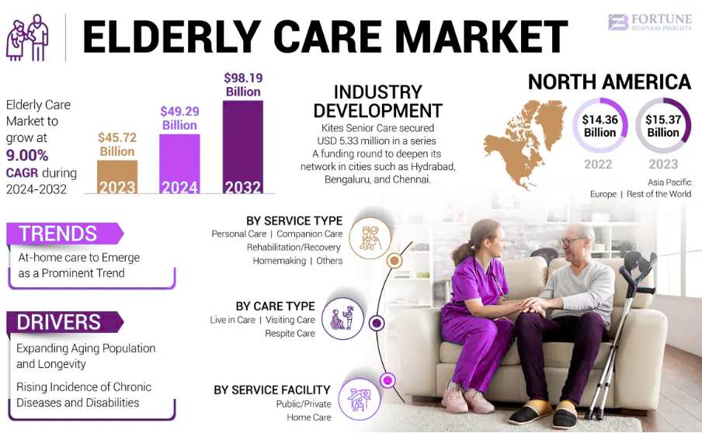
MARKET SIZE
“Fortune Business Insights. (2025, July 7). Elderly care market size, share & industry analysis, 2024–2032"
11

Slide 11
Market Validation
Validated by Over 50+ Survey Responses from Seniors and Family Caregivers
Engaged in Informal Interviews with Volunteers, Caregivers & Student Helpers
Received Strong Positive Feedback on the Need for Cognitive & Emergency Support
Commitments from Student Volunteers and NGOs for Support & Testing
3

Slide 12

Roadmap / Milestones
Plan for First Physical Care Facility Pilot (Year 3)
Introduce Premium Subscription & AI-Powered Features (Year 2)
Partner with 3-5 Local Senior Communities (Next 12 Months)
Launch Volunteer Matching System by (Month 8)
Onboard 50+ Early Users (Next 6 Months)
Launch MVP Platform (Next 3 Months)
11

Slide 13
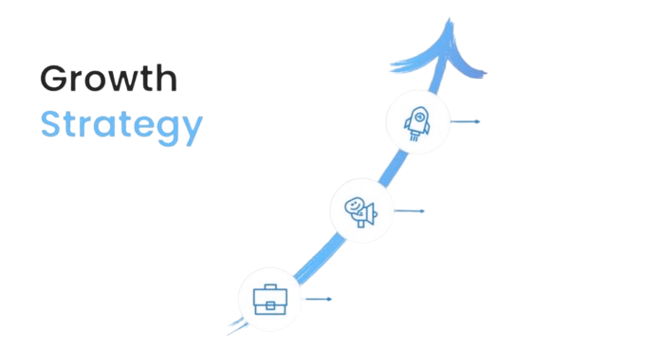
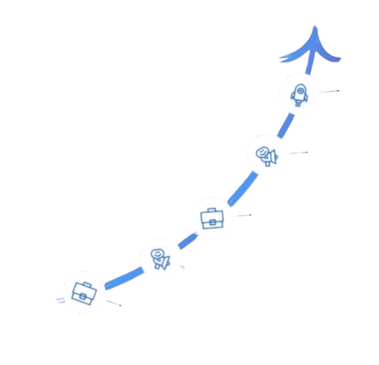
Partnerships with Healthcare Providers & Pharmacies
Storytelling via short-form reels & testimonials
Family-Driven Adoption Strategy
Word-of-Mouth & Referral Program
Participation in Health Tech Expos & Start-Up Incubators
11

Slide 14

The Ask
Growth support and Collaboration
Step 1
Step 2
Step 3
Access to Expert Advisory in Healthcare & Senior Wellness
Opportunities to Pilot with Senior Care Communities and plan pricings
Support with Legal, Data Privacy & Compliance Frameworks
(HELIX Launchpad Support)
10

Slide 15
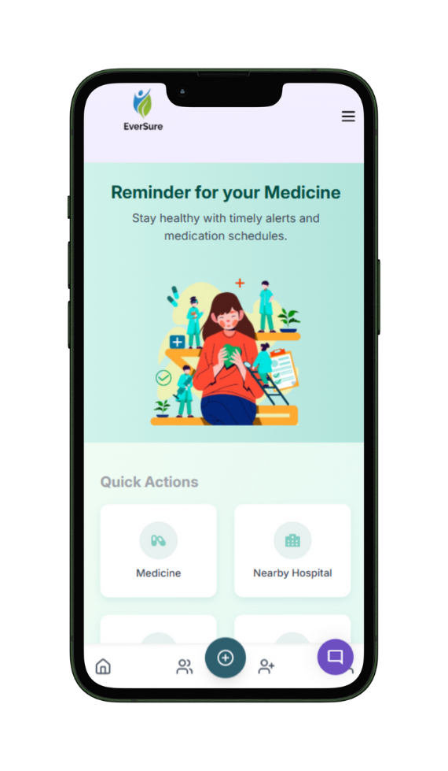

We’re building safer, healthier, and more connected lives for seniors.
Your support can help us make a lasting impact.
EverSure
10

